Slide 1

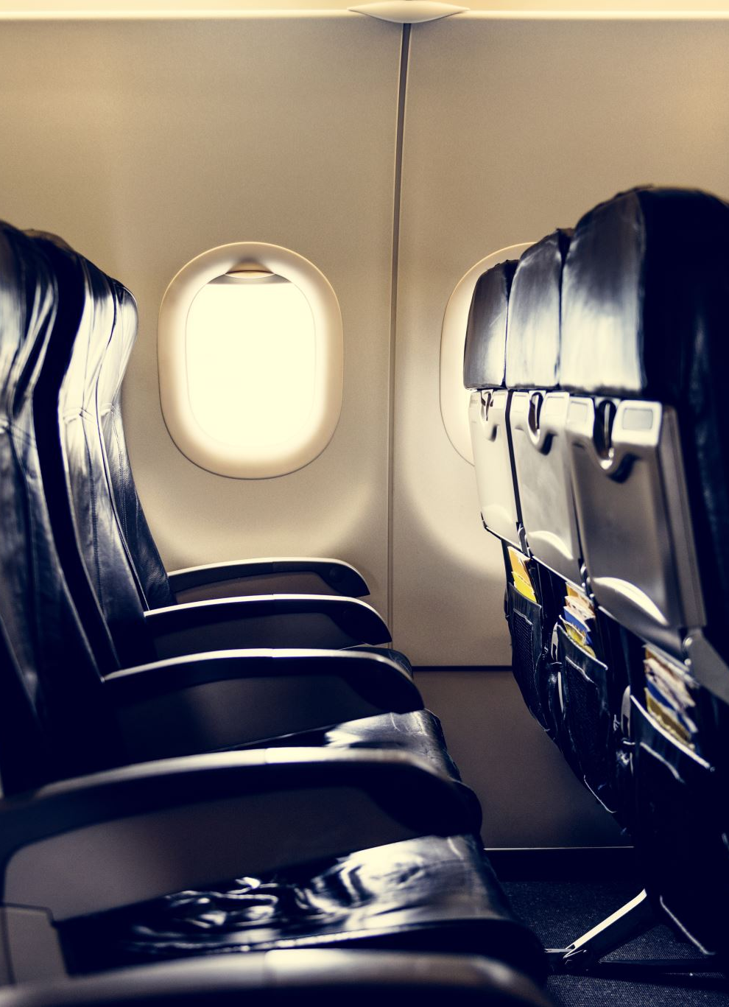
Airline Travel Safety
Alexa L. Wittlieff
College of Science and Technology, Bellevue University
DSC640-T301 Data Presentation & Visualization (2227-1)
Dr. Catie Williams
July 3, 2022

Slide 2
Purpose
Situation
The media is bombarding the public with claims that air travel is no longer safe.
To leverage data science for the investigation of the media’s claims and to educate the public

Slide 3
Agenda
Compare
air travel vs other modes of transportation
Review
recent airline industry safety trends
Discover
flight phases with the most accidents
Investigate
our airline’s plane performance
Uncover
most dangerous jet models

Slide 4
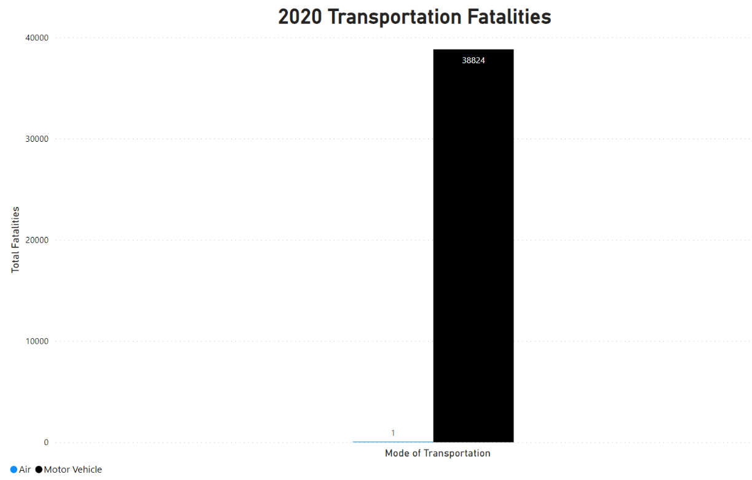
2020 Travel Fatalities by Mode of Transportation
In 2020, automobiles far outpaced airplanes in relation to transportation fatalities.

Slide 5
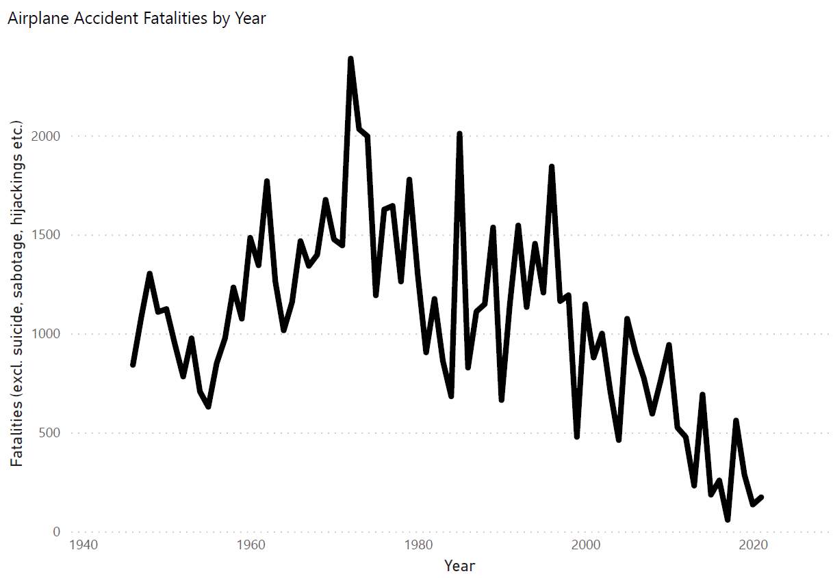
Airline Safety Trends
While airplane accident fatality numbers can fluctuate, overall airplane accident fatalities are on a downward trend.

Slide 6
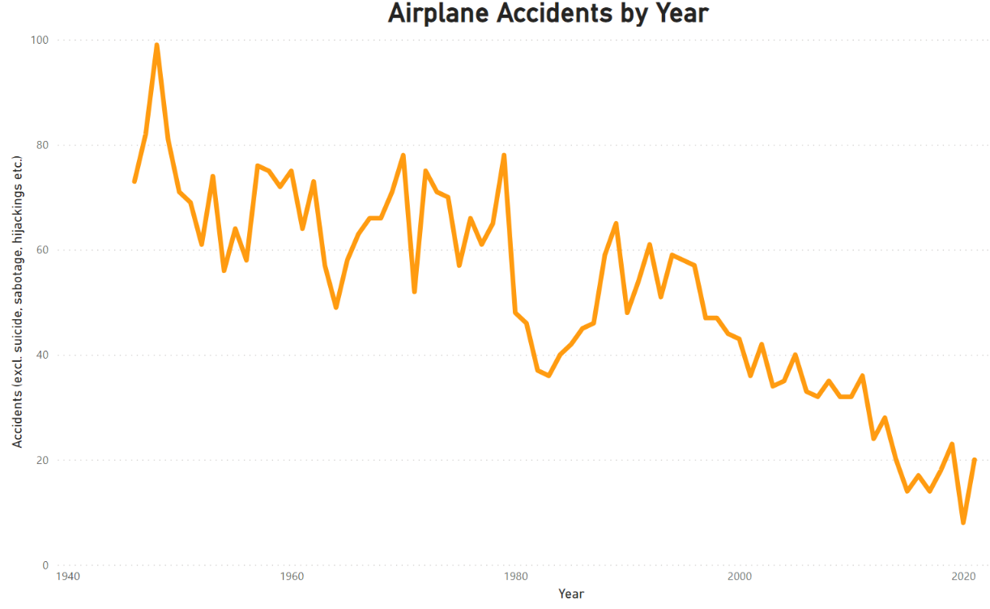
Airline Safety Trends
Airplane accidents are also seeing an overall downward trend.

Slide 7
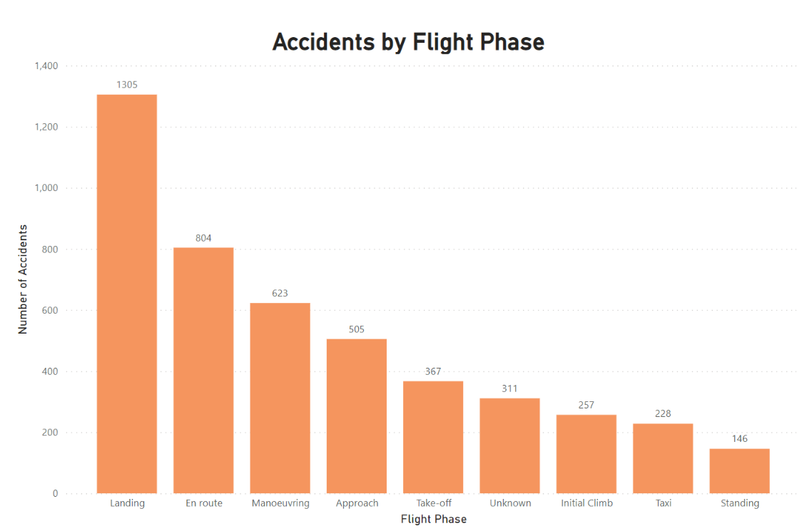
Flight Phases w. Most Accidents
Certain flight phases experience more accidents than others.
This may help us to uncover the phases on which to focus training and additional safety measures.

Slide 8
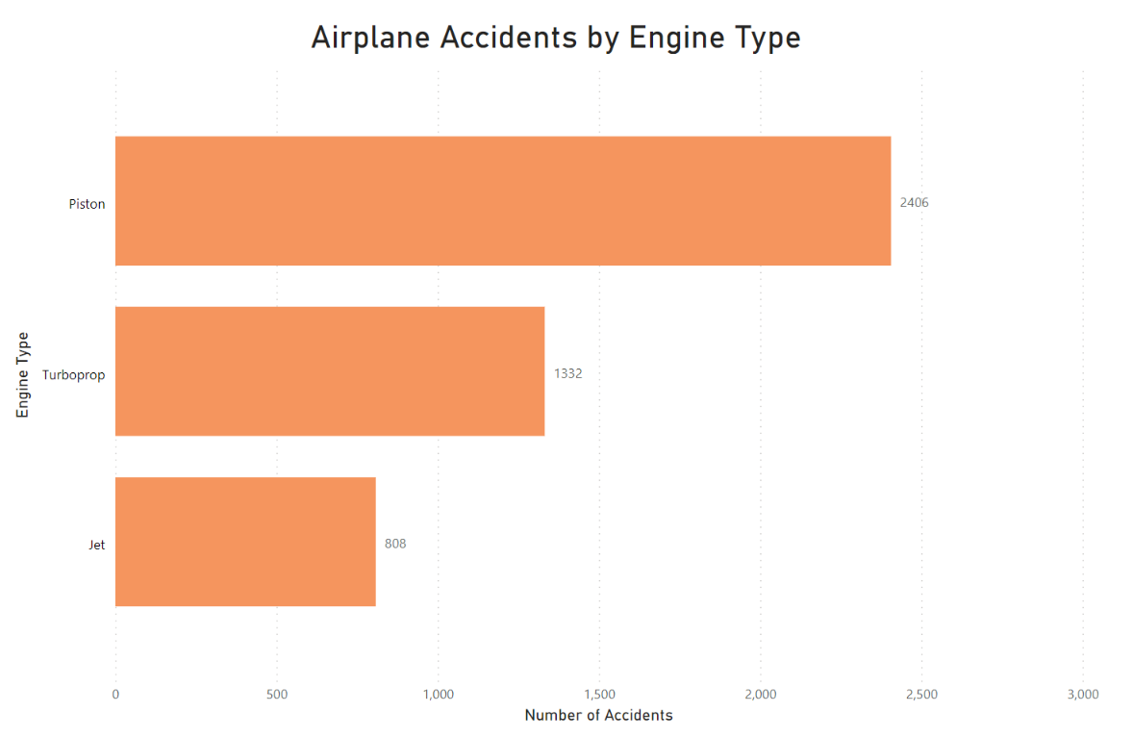
Wolf Airline’s Engine Choice Performance –
The Jet Engine
Our airline exclusively flies jet engine airplanes.
This engine type features the lowest number of associated accidents.

Slide 9
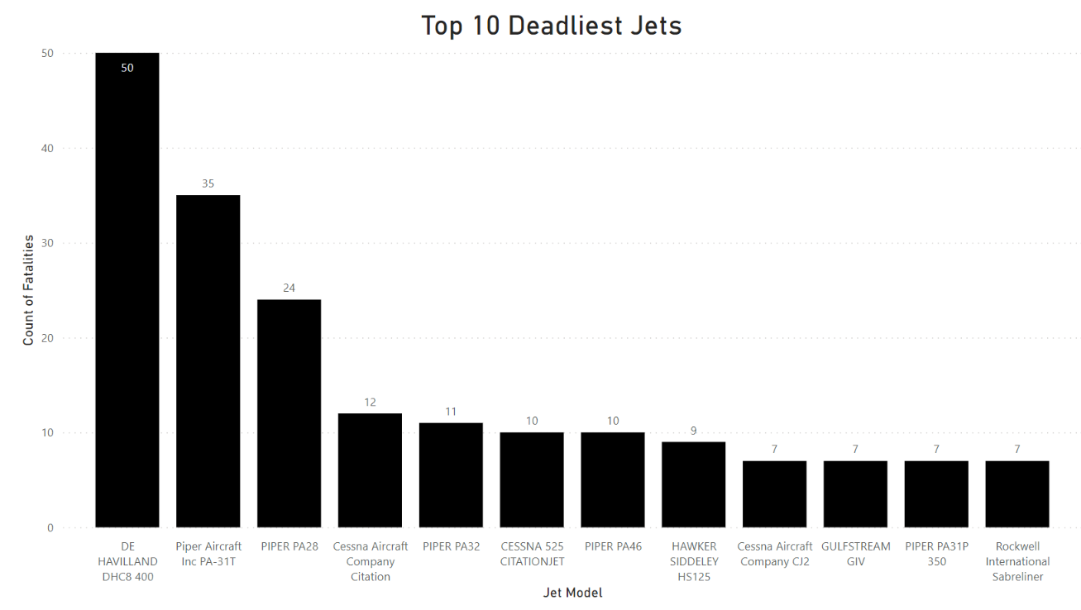
Deadliest Jets
Certain jet models are linked with higher fatalities than others.
By avoiding these models when adding to our fleet, we may be able to outperform competing airlines on safety.

Slide 10
Conclusion
Let’s tell our side of this story!
  Based on industry trends, airplane accidents and fatalities are down.
  Air travel is the safer mode of transportation.
Wolf Airlines values passenger safety!
  Enhanced training and safety measures for the most accident-prone flight phases
  Running the safest airplane engine type
  Avoiding the deadliest jets

